Slide 1
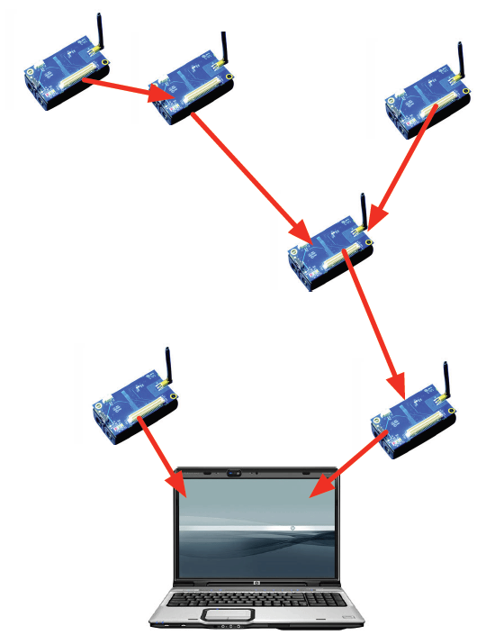
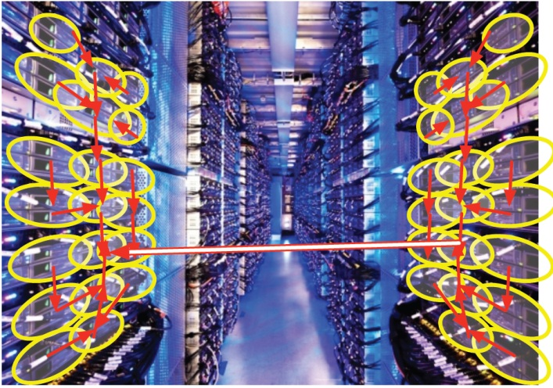
Summarizing Distributed Data
+
= ?
易珂
香港科技大学

Slide 2
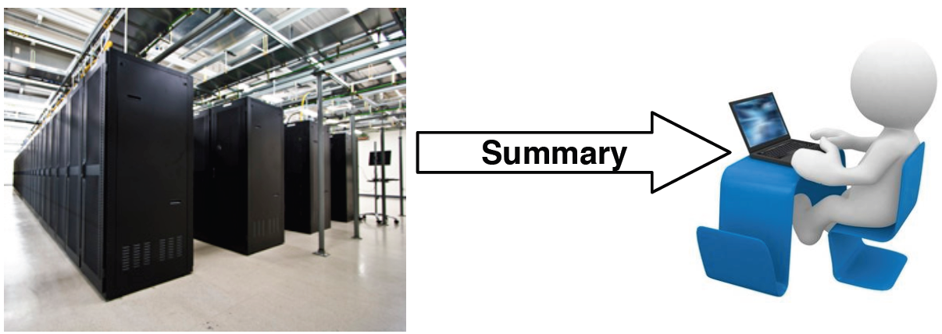
Small summaries for BIG data
Allows approximate computation with guarantees and small space – save space, time, and communication
Tradeoff between error and size

Slide 3
Summarization vs (Lossy) Compression
Summarization:
Compression
No need to decompress before making queries
Aims at particular properties of the data
(Usually) provides guarantees on query results
Need to decompress before making queries
Aims at generic approximation of all data
Best-effort approach; does not provide guarantees

Slide 4
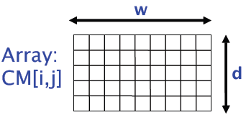
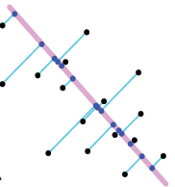
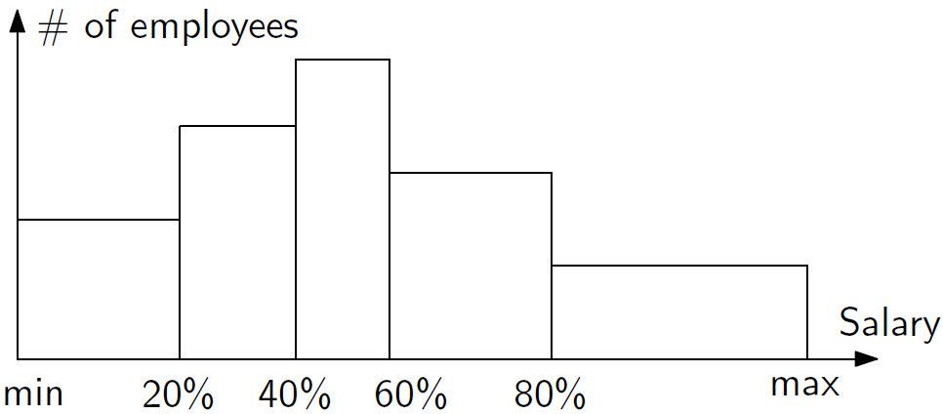
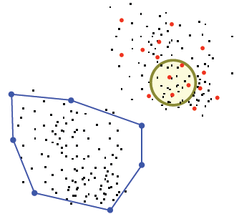
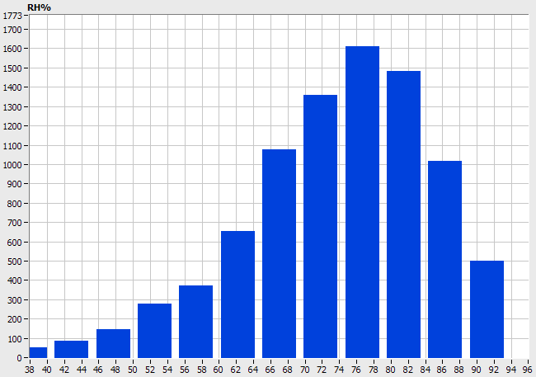
Summaries
Summaries allow approximate computations:
Random sampling
Frequent items
Sketches (JL transform, AMS, Count-Min, etc.)
Quantiles & histograms
Geometric coresets
…

Slide 5
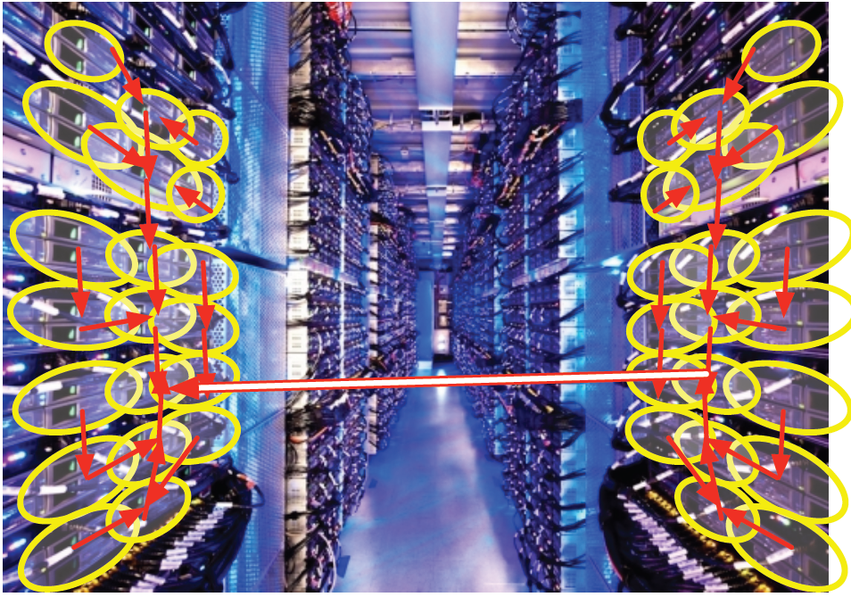
Large-scale distributed computation
Programmers have no control on how things are merged

Slide 6
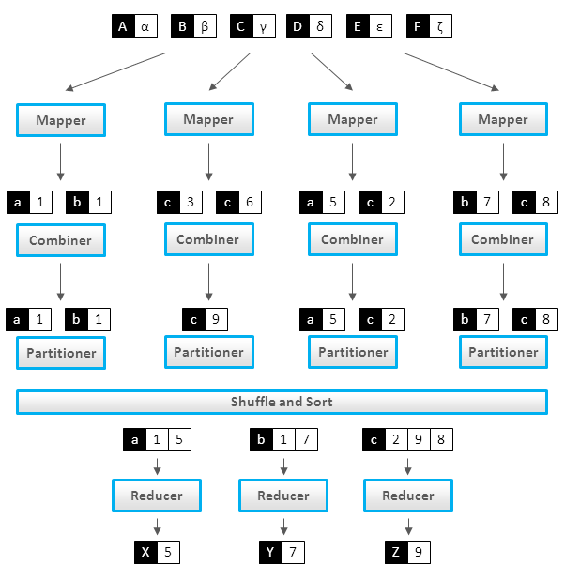
MapReduce

Slide 7
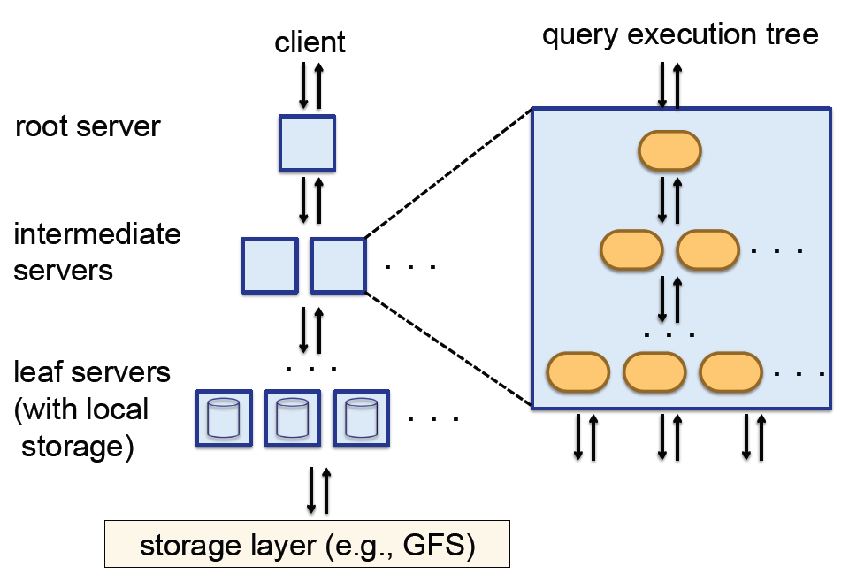
Dremel

Slide 8
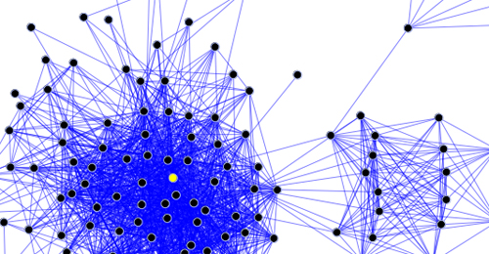
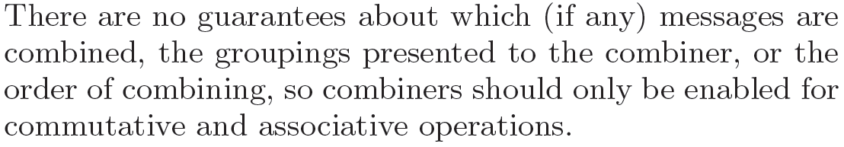
Pregel: Combiners

Slide 9
Sensor networks

Slide 10
“A major technical challenge for big data is to push summarization to edge devices.”
Jagadish et al, “Technical Challenges for Big Data”, Communications of the ACM, August 2014.

Slide 11
Mergeability
Ideally, summaries are algebraic: associative, commutative
Allows arbitrary computation trees (shape and size unknown to algorithm)
Quality remains the same
Any intermediate summary is valid
Resulting summary can be further merged
Generalizes the streaming model
Weaker requirement:
Size and/or shape of merging tree known in advance
Only the final summary is valid
Resulting summary may not be further merged
Possible to reduce communication/time cost

Slide 12
Summaries to be merged
Sketches
Random samples
MinHash
Heavy hitters
ε-approximations (quantiles, equi-height histograms)
Agarwal, Cormode, Huang, Phillips, Wei, and Yi, “Mergeable Summaries”, TODS, Nov 2013
easy
easy and cute
easy algorithm,
analysis requires work

Slide 13
Merging random samples
S₂
S₁
+
N₁ = 10
N₂ = 15
With prob. N₁/(N₁+N₂), take a sample from S₁

Slide 14
Merging random samples
S₂
S₁
+
N₁ = 9
N₂ = 15
With prob. N₁/(N₁+N₂), take a sample from S₁

Slide 15
Merging random samples
S₂
S₁
+
N₁ = 9
N₂ = 15
With prob. N₂/(N₁+N₂), take a sample from S₂

Slide 16
Merging random samples
S₂
S₁
+
N₁ = 9
N₂ = 14
With prob. N₂/(N₁+N₂), take a sample from S₂

Slide 17
Merging random samples
S₂
S₁
+
N₁ = 8
N₂ = 12
With prob. N₂/(N₁+N₂), take a sample from S₂
N₃ = 25

Slide 18
Merging sketches
Linear sketches (random projections) are easily mergeable
Data is multiset in domain [1..U], represented as vector x[1..U]
Count-Min sketch:
Creates a small summary as an array of w × d in size
Use d hash functions h_{j} to map vector entries to [1..w] on each row
Trivially mergeable: CM(x + y) = CM(x) + CM(y)
Array: CM[i,j]
d
x[i] = ?
return the min
w

Slide 19
MinHash
Hash function h
Retain the k elements with smallest hash values
Can be used to estimate set intersection size
Trivially mergeable

Slide 20
Summaries to be merged
Random samples
Sketches
MinHash
Heavy hitters
ε-approximations (quantiles, equi-height histograms)
easy
easy and cute
easy algorithm,
analysis requires work

Slide 21
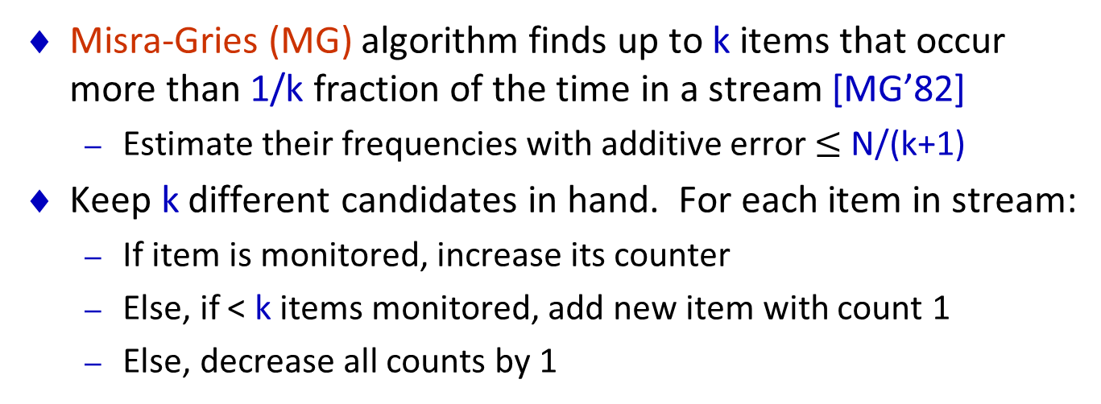
Heavy hitters
Misra-Gries (MG) algorithm finds up to k items that occur more than 1/k fraction of the time in a stream [MG’82]
Estimate their frequencies with additive error $≤$ N/(k+1)
Keep k different candidates in hand. For each item in stream:
If item is monitored, increase its counter
Else, if < k items monitored, add new item with count 1
Else, decrease all counts by 1
k=5
1 2 3 4 5 6 7 8 9

Slide 22
Heavy hitters
Misra-Gries (MG) algorithm finds up to k items that occur more than 1/k fraction of the time in a stream [MG’82]
Estimate their frequencies with additive error $≤$ N/(k+1)
Keep k different candidates in hand. For each item in stream:
If item is monitored, increase its counter
Else, if < k items monitored, add new item with count 1
Else, decrease all counts by 1
k=5
1 2 3 4 5 6 7 8 9

Slide 23
Heavy hitters
Misra-Gries (MG) algorithm finds up to k items that occur more than 1/k fraction of the time in a stream [MG’82]
Estimate their frequencies with additive error $≤$ N/(k+1)
Keep k different candidates in hand. For each item in stream:
If item is monitored, increase its counter
Else, if < k items monitored, add new item with count 1
Else, decrease all counts by 1
k=5
1 2 3 4 5 6 7 8 9

Slide 24
Streaming MG analysis
N = total input size
Previous analysis shows that the error is at most
N/(k+1) [MG’82] – standard bound, but too weak
F₁^{res(k)}/(k+1) [Berinde et al. TODS’10] – too strong
M = sum of counters in data structure
Error in any estimated count at most (N-M)/(k+1)
Estimated count a lower bound on true count
Each decrement spread over (k+1) items: 1 new one and k in MG
Equivalent to deleting (k+1) distinct items from stream
At most (N-M)/(k+1) decrement operations
Hence, can have “deleted” (N-M)/(k+1) copies of any item
So estimated counts have at most this much error

Slide 25
Merging two MG summaries
Merging algorithm:
Merge two sets of k counters in the obvious way
Take the (k+1)th largest counter = C_{k+1}, and subtract from all
Delete non-positive counters
k=5
1 2 3 4 5 6 7 8 9

Slide 26
Merging two MG summaries
This algorithm gives mergeability:
Merge subtracts at least (k+1)C_{k+1} from counter sums
So (k+1)C_{k+1} ≤ (M₁ + M₂ – M₁₂)
Sum of remaining (at most k) counters is M₁₂
By induction, error is ((N₁-M₁) + (N₂-M₂) + (M₁+M₂–M₁₂))/(k+1)=((N₁+N₂) –M₁₂)/(k+1)
(prior error)
(from merge)
(as claimed)
k=5
C_{k+1}
1 2 3 4 5 6 7 8 9

Slide 27
Compare with previous merging algorithms
Two previous merging algorithms for MG [Manjhi et al. SIGMOD’05, ICDE’05]
No guarantee on size
Error increases after each merge
Need to know the size or the height of the merging tree in advance for provisioning

Slide 28
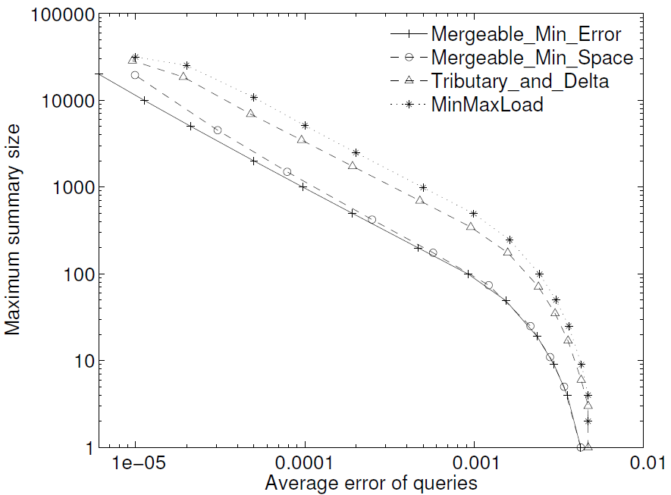
Compare with previous merging algorithms
Experiment on a BFS routing tree over 1024 randomly deployed sensor nodes
Data
Zipf distribution

Slide 29
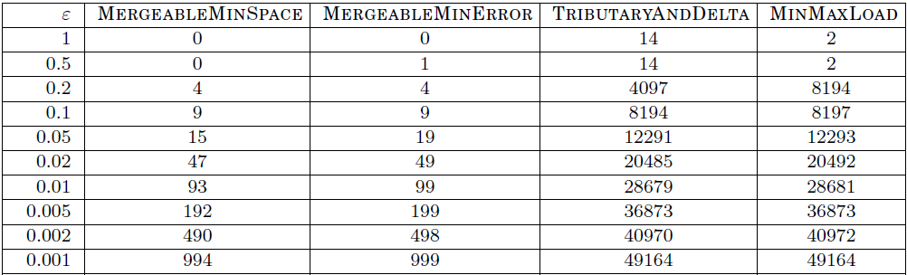
Compare with previous merging algorithms
On a contrived example

Slide 30
SpaceSaving: Another heavy hitter summary
At least 10+ papers on this problem
The “SpaceSaving” (SS) summary also keeps k counters [Metwally et al. TODS’06]
If stream item not in summary, overwrite item with least count
SS seems to perform better in practice than MG
Surprising observation: SS is actually isomorphic to MG!
An SS summary with k+1 counters has same info as MG with k
SS outputs an upper bound on count, which tends to be tighter than the MG lower bound
Isomorphism is proved inductively
Show every update maintains the isomorphism
Immediate corollary: SS is mergeable

Slide 31
Summaries to be merged
Random samples
Sketches
MinHash
Heavy hitters
ε-approximations (quantiles, equi-height histograms)
easy
easy and cute
easy algorithm,
analysis requires work

Slide 32
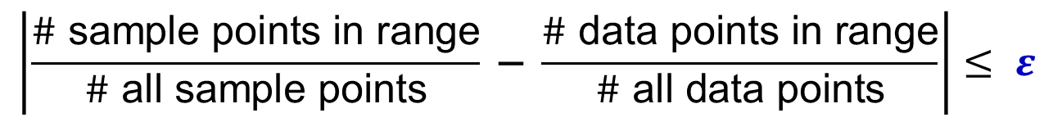
ε-approximations: a more “uniform” sample
Random sample:
$$\left|\frac{\# \text{sample} \text{points} \text{in} \text{range}}{\# \text{all} \text{sample} \text{points}} \text{−} \frac{\# \text{data} \text{points} \text{in} \text{range}}{\# \text{all} \text{data} \text{points}}\right|≤ ε$$
A “uniform” sample needs 1/ε sample points
A random sample needs Θ(1/ε²) sample points (w/ constant prob.)

Slide 33
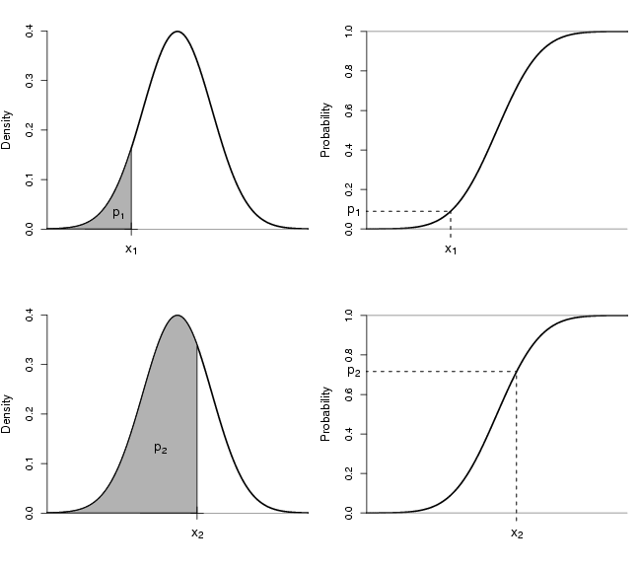
Quantiles (order statistics)
Quantiles generalize median:
Exact answer: CDF⁻¹(φ) for 0 < φ < 1
Approximate version: tolerate answer in CDF⁻¹(φ-ε)…CDF⁻¹(φ+ε)
ε-approximation solves dual problem: estimate CDF(x) ± ε
Binary search to find quantiles

Slide 34
Quantiles gives equi-height histogram
Automatically adapts to skew data distributions
Equi-width histograms (fixed binning) are trivially mergeable but does not adapt to data distribution

Slide 35
Previous quantile summaries
Streaming
At least 10+ papers on this problem
GK algorithm: O(1/ε log n) [Greenwald and Khana, SIGMOD’01]
Randomized algorithm: O(1/ε log³(1/ε)) [Suri et al. DCG’06]
Mergeable
Q-digest: O(1/ε log U) [Shrivastava et al. Sensys’04] Requires a fixed universe of size U
[Greenwald and Khana, PODS’04] Error increases after each merge (not truly mergeable!)
New: O(1/ε log^{1.5}(1/ε)) Works in comparison model

Slide 36
Equal-weight merges
A classic result (Munro-Paterson ’80):
Base case: fill summary with k input points
Input: two summaries of size k, built from data sets of the same size
Merge, sort summaries to get size 2k
Take every other element
Error grows proportionally to height of merge tree
Randomized twist:
Randomly pick whether to take odd or even elements
1 5 6 7 8
+
2 3 4 9 10
1 3 5 7 9

Slide 37
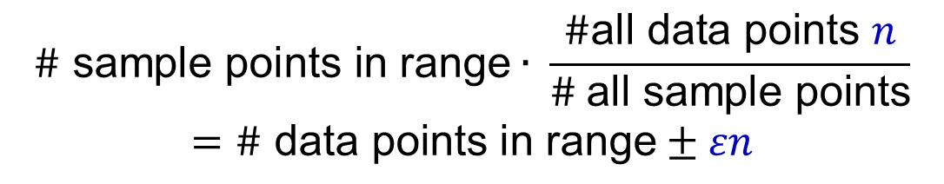
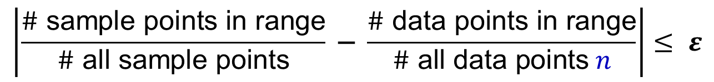
Equal-weight merge analysis: Base case
$$\left|\frac{\# \text{sample} \text{points} \text{in} \text{range}}{\# \text{all} \text{sample} \text{points}} \text{−} \frac{\# \text{data} \text{points} \text{in} \text{range}}{\# \text{all} \text{data} \text{points} n}\right|≤ ε$$
2
$$\# \text{sample} \text{points} \text{in} \text{range}∙ \frac{\#\text{all} \text{data} \text{points} n}{\# \text{all} \text{sample} \text{points}}$$
$$=\# \text{data} \text{points} \text{in} \text{range}±εn$$
Let the resulting sample be S. Consider any interval I
Estimate 2| I ∩ S| is unbiased and has error at most 1
| I ∩ D| is even: 2| I ∩ S| has no error
| I ∩ D| is odd: 2| I ∩ S| has error ± 1 with equal prob.

Slide 38
Equal-weight merge analysis: Multiple levels
Consider j’th merge at level i of L^{(i-1)}, R^{(i-1)} to S^{(i)}
Estimate is 2^{i} | I ∩ S^{(i)} |
Error introduced by replacing L, R with S is X_{i,j} = 2^{i} | I ∩ S^{i} | - (2^{i-1} | I ∩ (L^{(i-1)} ∪ R^{(i-1)})|) (new estimate) (old estimate)
Absolute error |X_{i,j}| ≤ 2^{i-1} by previous argument
Bound total error over all m levels by summing errors:
M = ∑_{i,j} X_{i,j} = ∑_{1≤ i ≤ m} ∑_{1≤ j ≤ 2}^{m-i} X_{i,j}
max |M| grows with levels
Var[M] doesn’t! (dominated by highest level)
Level i=4
Level i=3
Level i=2
Level i=1

Slide 39
Equal-sized merge analysis: Chernoff bound
Chernoff-Hoeffding: Give unbiased variables Y_{j} s.t. |Y_{j}| ≤ y_{j} : Pr[ abs(∑_{1 ≤ j ≤ t} Y_{j} ) > α ] ≤ 2exp(-2α²/∑_{1 ≤ j ≤ t} (2y_{j})²)
Set α = h 2^{m} for our variables:
2α²/(∑_{i} ∑_{j} (2 max(X_{i,j})²) = 2(h2^{m})² / (∑_{i} 2^{m-i} . 2^{2i}) = 2h² 2^{2m} / ∑_{i} 2^{m+i} = 2h² / ∑_{i} 2^{i-m} = 2h² / ∑_{i} 2^{-i} ≥ 2h²
From Chernoff bound, error probability is at most 2exp(-2h²)
Set h = O(log^{1/2} δ⁻¹) to obtain 1-δ probability of success
Level i=4
Level i=3
Level i=2
Level i=1

Slide 40
Equal-sized merge analysis: finishing up
Chernoff bound ensures absolute error at most α=h2^{m}
m is number of merges = log (n/k) for summary size k
So error is at most hn/k
Set size of each summary k to be O(h/ε) = O(1/ε log^{1/2} 1/δ)
Guarantees give εn error with probability 1-δ for any one range
There are O(1/ε) different ranges to consider
Set δ = Θ(ε) to ensure all ranges are correct with constant probability
Summary size: O(1/ε log^{1/2} 1/ε)

Slide 41
Fully mergeable ε-approximation
Use equal-size merging in a standard logarithmic trick:
Merge two summaries as binary addition
Fully mergeable quantiles, in O(1/ε log n log^{1/2} 1/ε)
n = number of items summarized, not known a priori
But can we do better?
Wt 32
Wt 16
Wt 8
Wt 4
Wt 2
Wt 1
Wt 32
Wt 16
Wt 8
Wt 4
Wt 2
Wt 1
Wt 32
Wt 16
Wt 8
Wt 4
Wt 4
Wt 2
Wt 1

Slide 42
Hybrid summary
Classical result: It’s sufficient to build the summary on a random sample of size Θ(1/ε²)
Problem: Don’t know n in advance
Hybrid structure:
Keep top O(log 1/ε) levels: summary size O(1/ε log^{1.5}(1/ε))
Also keep a “buffer” sample of O(1/ε) items
When buffer is “full”, extract points as a sample of lowest weight
Wt 32
Wt 16
Wt 8
Buffer

Slide 43
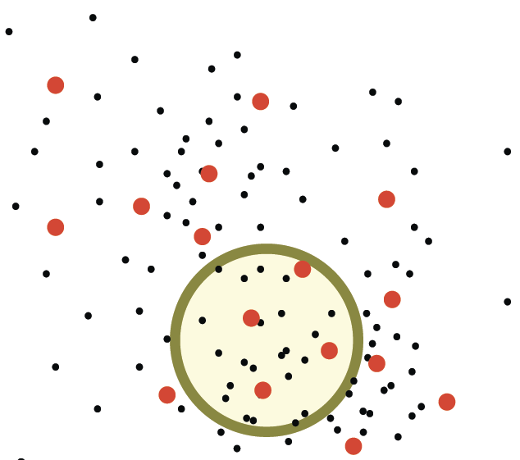
ε-approximations in higher dimensions
ε-approximations generalize to range spaces with bounded VC-dimension
Generalize the “odd-even” trick to low-discrepancy colorings
ε-approx for constant VC-dimension d has size Õ(ε^{-2d/(d+1)})

Slide 44
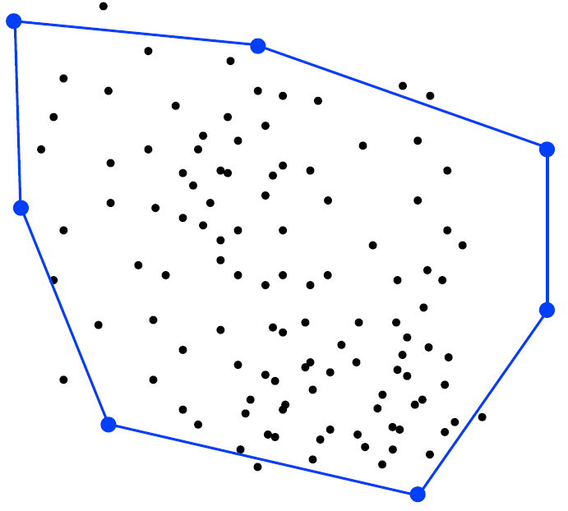
Other mergeable summaries: ε-kernels
ε-kernels in d-dimensional space approximately preserve the projected extent in any direction
ε-kernel has size O(1/ε^{(d-1)/2})
Streaming ε-kernel has size O(1/ε^{(d-1)/2} log(1/ε))
Mergeable ε-kernel has size O(1/ε^{(d-1)/2} log^{d}n)

Slide 45
Summary
 | Static | Streaming | Mergeable
Heavy hitters | 1/ε | 1/ε | 1/ε
ε-approximation (quantiles) deterministic | 1/ε | 1/ε log n | 1/ε log U
ε-approximation (quantiles) randomized | - | 1/ε log^{1.5}(1/ε) | 1/ε log^{1.5}(1/ε)
ε-kernel | 1/ε^{(d-1)/2} | 1/ε^{(d-1)/2} log(1/ε) | 1/ε^{(d-1)/2} log^{d}n

Slide 46
Open problems
Better bound on mergeable ε-kernels
Match the streaming bound?
Lower bounds for mergeable summaries
Separation from streaming model?
Other streaming algorithms (summaries)
L_{p} sampling
Coresets for minimum enclosing balls (MEB)

Slide 47
Hybrid analysis (sketch)
Keep the buffer (sample) size to O(1/ε)
Accuracy only √ε n
If buffer only summarizes O(εn) points, this is OK
Analysis rather delicate:
Points go into/out of buffer, but always moving “up”
Number of “buffer promotions” is bounded
Similar Chernoff bound to before on probability of large error
Gives constant probability of accuracy in O(1/ε log^{1.5}(1/ε)) space

Slide 48
Models of summary construction
Offline computation: e.g. sort data, take percentiles
Streaming: summary merged with one new item each step
One-way merge
Caterpillar graph of merges
Equal-weight merges: can only merge summaries of same weight
Full mergeability (algebraic): allow arbitrary merging trees
Our main interest

Slide 49
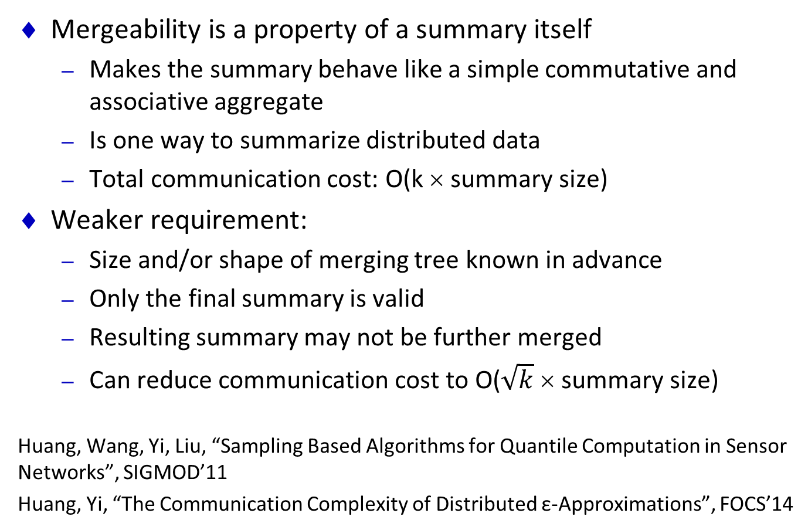
Mergeability vs Summarizing Distributed Data
Mergeability is a property of a summary itself
Makes the summary behave like a simple commutative and associative aggregate
Is one way to summarize distributed data
Total communication cost: O(k × summary size)
Weaker requirement:
Size and/or shape of merging tree known in advance
Only the final summary is valid
Resulting summary may not be further merged
Can reduce communication cost to O($\sqrt{k} \text{× }\text{summary} \text{size}\text{)}$
Huang, Wang, Yi, Liu, “Sampling Based Algorithms for Quantile Computation in Sensor Networks”, SIGMOD’11
Huang, Yi, “The Communication Complexity of Distributed ε-Approximations”, FOCS’14

Slide 50
Thank you!

